Slide 1

OMGT1039
Operations Management
Week 11
Reliability and Maintenance

Slide 2
COMMONWEALTH OF AUSTRALIA
Copyright Regulations 1969
WARNING
This material has been reproduced and communicated
to you by or on behalf of Royal Melbourne Institute
of Technology, (RMIT University) pursuant to Part
VB of the Copyright Act 1968 (the Act).
The material in this communication may be subject to
copyright under the Act. Any further reproduction or
communication of this material by you may be the
subject of copyright protection under the Act.
Do not remove this notice.
First page of scanned document
This presentation includes selected slides from
William J Stevenson (2015) Operations Management, 12 ed. ISBN 10: 1259580091, McGraw Hill

Slide 3
Learning Objectives
  Define reliability
  Perform simple reliability computations
  Explain the term availability and perform simple calculations
  Explain the importance of maintenance in production systems
  Discuss preventive maintenance and the key issues associated with it
  Explain breakdown maintenance and name the key issues associated with it

Slide 4
Reliability
Reliability
  The ability of a product, part, or system to perform its intended function under a prescribed set of conditions
  Reliability is expressed as a probability
  How to Quantify
    The probability that the product or system will function when activated
    The probability that the product or system will function for a given length of time

Slide 5
Reliability – When Activated
Finding the probability under the assumption that the system consists of a number of independent components
  Requires the use of probabilities for independent events
    Independent event
      Events whose occurrence or non-occurrence do not influence one another

Slide 6
Reliability – When Activated (contd.)
Rule 1
  If two or more events are independent and success is defined as the probability that all of the events occur, then the probability of success is equal to the product of the probabilities of the events

Slide 7
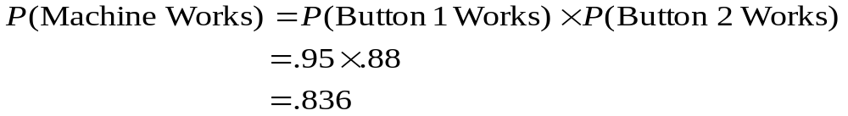
Example – Rule 1
A machine has two buttons. In order for the machine to function, both buttons must work. One button has a probability of working of .95, and the second button has a probability of working of .88.
Button 1
.95
Button 2
.88

Slide 8

Reliability – When Activated (contd.)
Though individual system components may have high reliabilities, the system’s reliability may be considerably lower because all components that are in series must function
One way to enhance reliability is to utilize redundancy
Redundancy: The use of backup components to increase reliability

Slide 9
Reliability – When Activated (contd.)
Rule 2
  If two events are independent and success is defined as the probability that at least one of the events will occur, the probability of success is equal to the probability of either one plus 1.00 minus that probability multiplied by the other probability

Slide 10
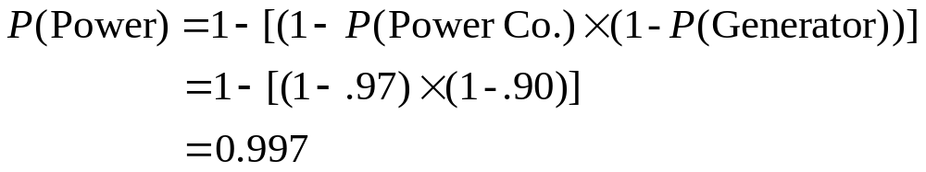
Example – Rule 2
A restaurant located in area that has frequent power outages has a generator to run its refrigeration equipment in case of a power failure. The local power company has a reliability of .97, and the generator has a reliability of .90. The probability that the restaurant will have power is
Generator
.90
Power Co.
.97

Slide 11
Reliability – When Activated (contd.)
Rule 3(extension of Rule 2)
  If two or more events are involved and success is defined as the probability that at least one of them occurs, the probability of success is 1 - P(all fail).

Slide 12
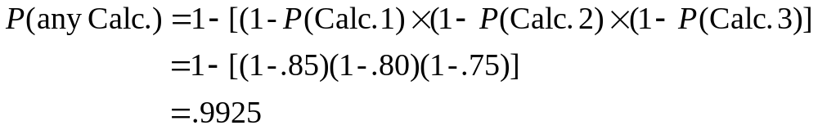
Example – Rule 3 (extension of Rule 2)
A student takes three calculators (with reliabilities of .85, .80, and .75) to her exam. Only one of them needs to function for her to be able to finish the exam. What is the probability that she will have a functioning calculator to use when taking her exam?
Calc. 3
.75
Calc. 2
.80
Calc. 1
.85

Slide 13
What is this system’s reliability?
.75
.80
.80
.70
.95
.85
.90
output
input

Slide 14
What is this system’s reliability?
.75
.80
.80
.70
.95
.85
.90
output
input
Answer
.99
.9925
.97
Step 1
.9531
Step 2

Slide 15
Reliability – Over Time
In this case, reliabilities are determined relative to a specified length of time.
This is a common approach to viewing reliability when establishing warranty periods

Slide 16
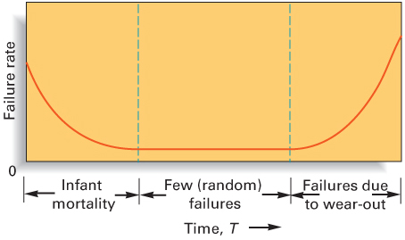
The Bathtub Curve

Slide 17
Distribution and Length of Phase
To properly identify the distribution and length of each phase requires collecting and analyzing historical data
Two important distributions are discussed in next few slides which are: Exponential Distribution, and Normal distribution,

Slide 18
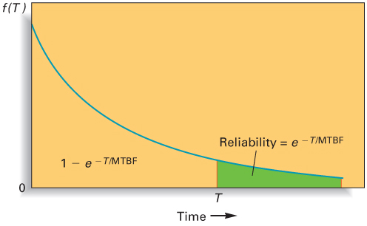
Exponential Distribution
Areas between 0 and T = probability of failure
Areas beyond T = Reliability

Slide 19
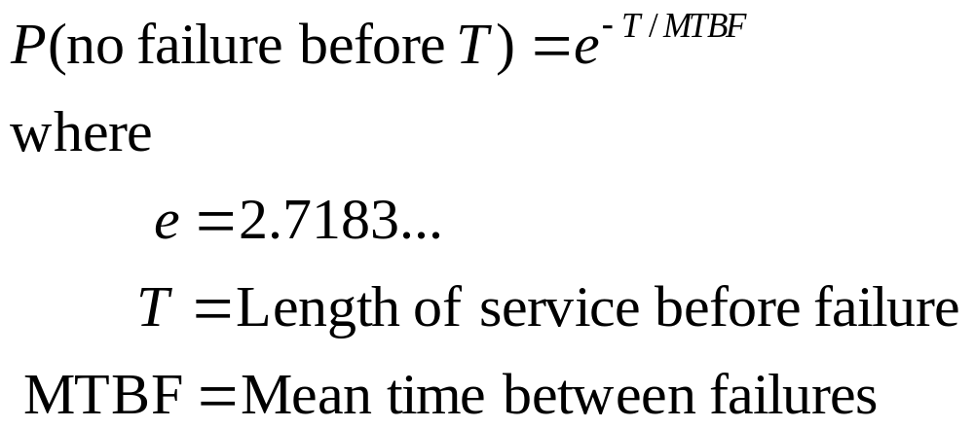
Exponential Distribution – Formulae

Slide 20
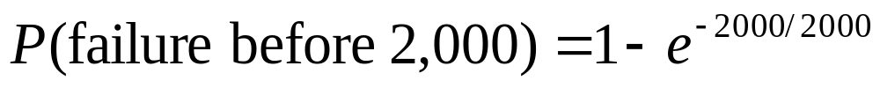
Example – Exponential Distribution
A light bulb manufacturer has determined that its 150 watt bulbs have an exponentially distributed mean time between failures of 2,000 hours. What is the probability that one of these bulbs will fail before 2,000 hours have passed?
    e^{-2000/2000} = e⁻¹
    e⁻¹ = 0.3679
    So, the probability one of these bulbs will fail before 2,000 hours is 1 - 0.3679 = 0.6321

Slide 21
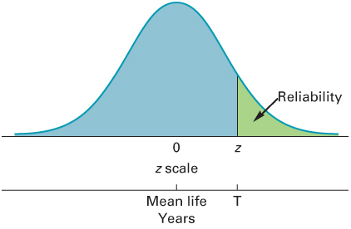
Normal Distribution
Sometimes, failures due to wear-out can be modeled using the normal distribution

Slide 22
Normal Distribution example
The mean life of a certain ball bearing can be modelled using a normal distribution with a mean of six years and a standard deviation of one year. Determine each of the following:
a. What is the probability that a ball bearing will wear out before seven years of service?
b. The service life that will provide a wear-out probability of 10 percent.

Slide 23
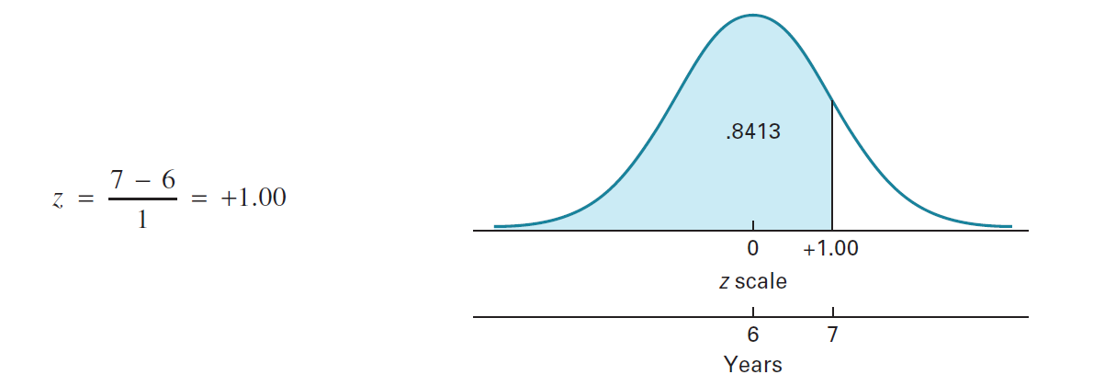
Normal Distribution example
a. Compute z and use it to obtain the probability:
Thus, P ( T < 7) = 0.8413 or %84.13

Slide 24
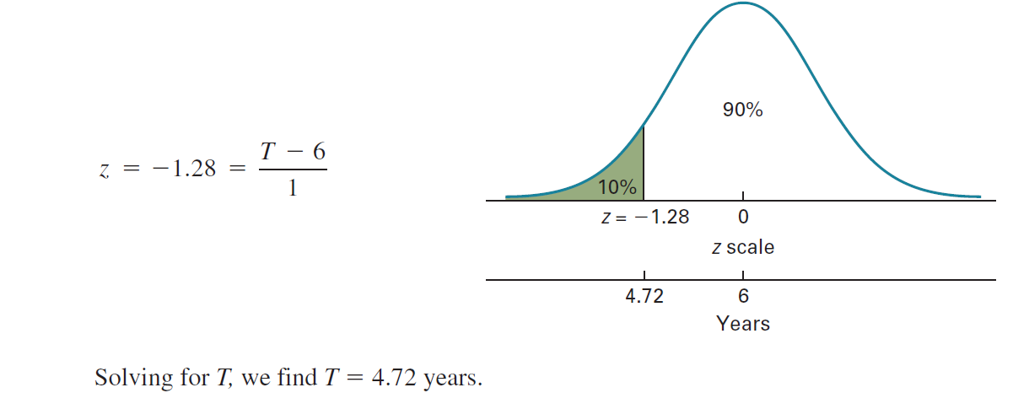
b.

Slide 25
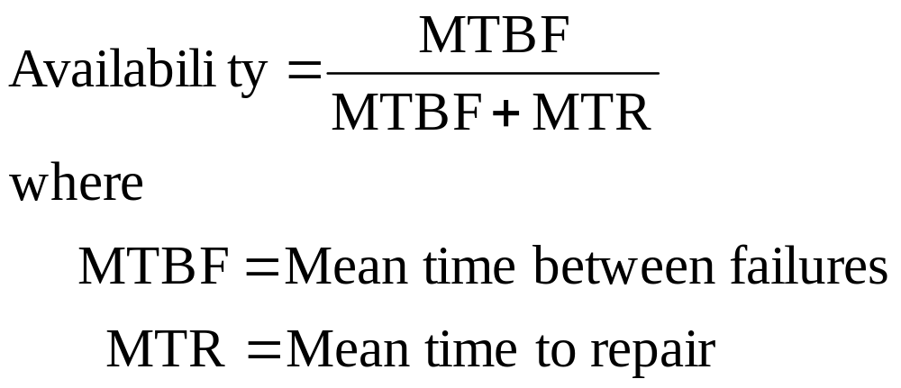
Availability
Availability
  The fraction of time a piece of equipment is expected to be available for operation
Mean time between failures (MTBF): The average length of time between failures of a product or component.

Slide 26
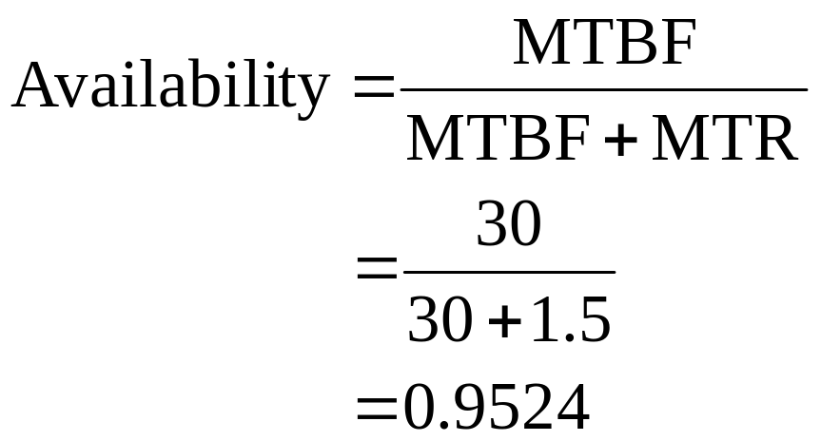
Example – Availability
John Q. Student uses a laptop at school. His laptop operates 30 weeks on average between failures. It takes 1.5 weeks, on average, to put his laptop back into service. What is the laptop’s availability?

Slide 27
Maintenance
Maintenance
  All activities that maintain facilities and equipment in good working order so that a system can perform as intended
  Maintenance activity categories:
    Buildings and grounds
    Equipment maintenance

Slide 28
Maintenance Goals
The goal of maintenance is to keep the production system in good working order at minimal cost
Reasons for wanting to keep equipment and machines in good operating condition:
  Avoid production or service disruptions
  Not add to production or service costs
  Maintain high quality
  Avoid missed delivery dates

Slide 29
Breakdown Consequences
Operations capacity is reduced, and orders are delayed
There is no output, but overhead continues, increasing the cost per unit
There are quality issues
  Output may be damaged
There are safety issues
  Employees or customers may be injured

Slide 30
Maintenance Options
Reactive:
  Breakdown maintenance
    Dealing with breakdowns or problems when they occur
Proactive:
  Preventive maintenance
    Reducing breakdowns through a program of lubrication, adjustment, cleaning, inspection, and replacement of worn parts

Slide 31
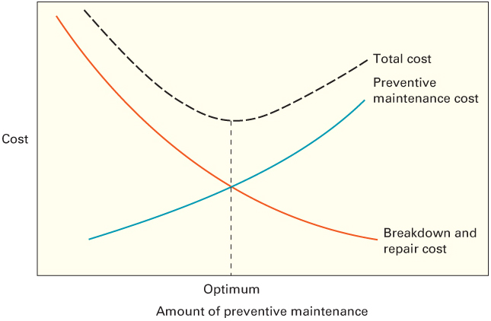
Total Maintenance Cost

Slide 32
Preventive Maintenance
The goal of preventive maintenance is to reduce the incidence of breakdown or failures in the plant or equipment to avoid the associated costs
  Loss of output
  Idle workers
  Schedule disruption
  Injuries
  Damage to other equipment, products, or facilities
  Repairs

Slide 33
Preventive Maintenance Schedule
It is periodic
It can be scheduled according to the availability of maintenance personnel and to avoid interference with operating schedules
Maintenance is scheduled using some combination of
  The result of planned inspections that reveal a need for maintenance
  According to the calendar (passage of time)
  After a predetermined number of operating hours

Slide 34
Preventive Maintenance: Frequency
The goal is to strike a balance between the cost of preventive maintenance and the cost of breakdown
The amount of preventive maintenance, therefore, is a function of the expected frequency of breakdown, the cost of breakdown, and the cost of preventive maintenance

Slide 35
Frequency: Example 1
The frequency of breakdown of a machine per month is $1,000 and the cost of preventive maintenance is $1,250 per month. If preventive maintenance is performed, the probability of a machine breakdown is negligible. Should the manager use preventive maintenance, or would it be cheaper to repair the machine when it breaks down?
Number of breakdowns | 0 | 1 | 2 | 3
Frequency of occurrences | 0.20 | 0.30 | 0.40 | 0.10

Slide 36
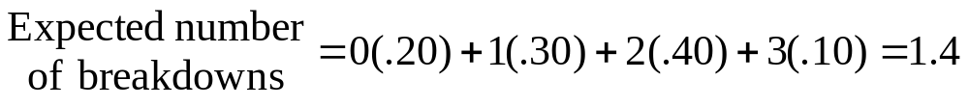
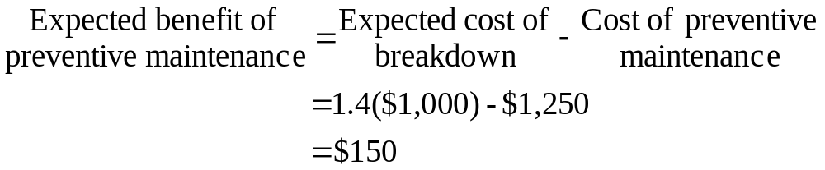
Frequency: Example 1
Number of breakdowns | 0 | 1 | 2 | 3
Frequency of occurrences | 0.20 | 0.30 | 0.40 | 0.10
So it is better to use preventive maintenance: monthly saving of $150

Slide 37
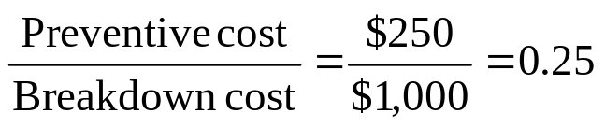
Frequency: Example 2
Suppose the average time before breakdown is normally distributed with a mean of 3 weeks and a standard deviation of 0.60 weeks. If breakdown cost averages $1,000 and preventive maintenance costs $250, what is the optimal maintenance interval?
Answer:
Find the number of standard deviations from the mean represented by an area under the normal curve of 0.25
Using the standard normal table, it is -0.67
    Use this value to determine the maintenance interval

Slide 38
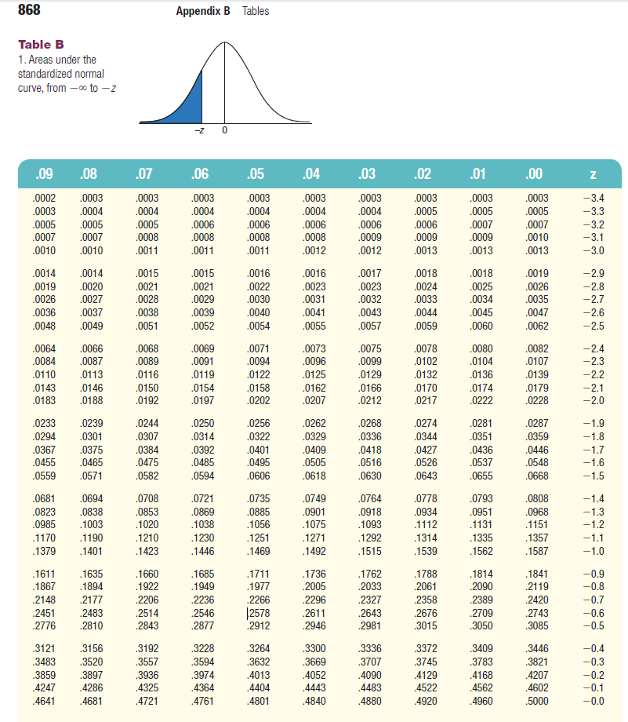
You can use any standardized normal table
You can use any standardized normal table

Slide 39
Question

